Slide 1
Dragon Crown
By: Steven Chamale

Slide 2
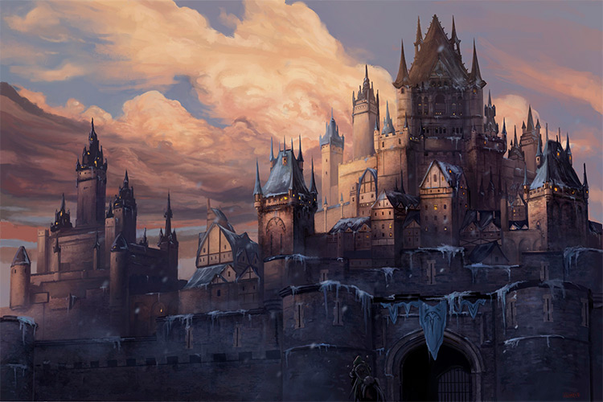
Story Concept
The kingdom has a weak ruler and the nation is growing restless
The King is known for being weak.
A Ku is going to take place
And the leader of the ku needs to kill the royal family

Slide 3
How To Play
Move with WASD
Jump with Space Button
Attack with numerical keyboard 1, 2 and 3.

Slide 4
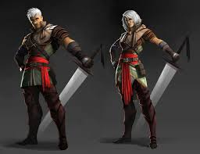
Main Characters
Kenwick is a childhood friend who has known the princess since they were children

Slide 5
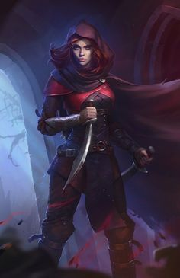
Main Characters
Kalie is the princess and a bit naïve
Grows to be a strong fighter through her surviving the attack of the castle
Also knows the leader of the ku and wishes to take her kingdom back

Slide 6
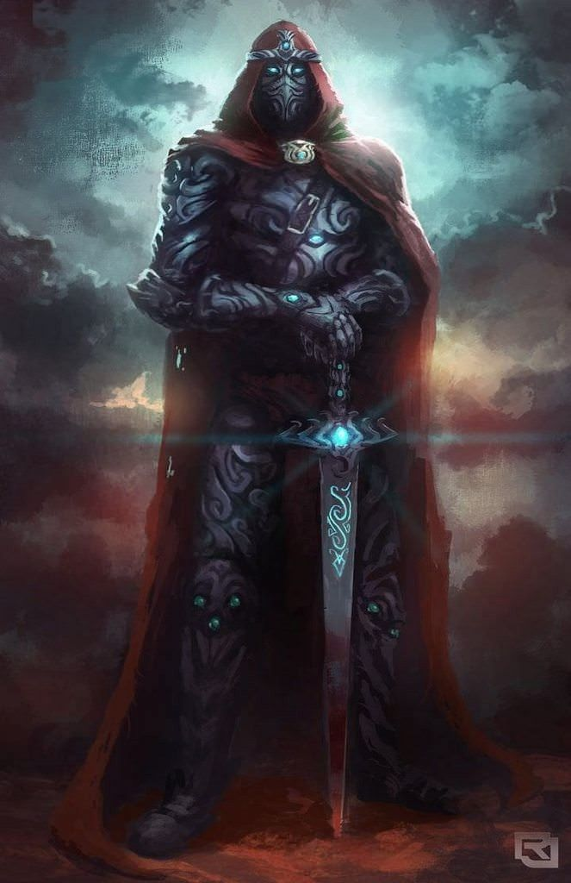
Antagonist
Aster
Choice to lead the revolt against the King.
Grey area type of character
Decided to revolt against the king because of neighboring nations.

Slide 7
Game Mechanics
First a Video https://www.youtube.com/watch?v=Wi7BoLAAvgo
One of your favorite things about fighting games?
Mixing in the two genres
Mainly the combo system

Slide 8
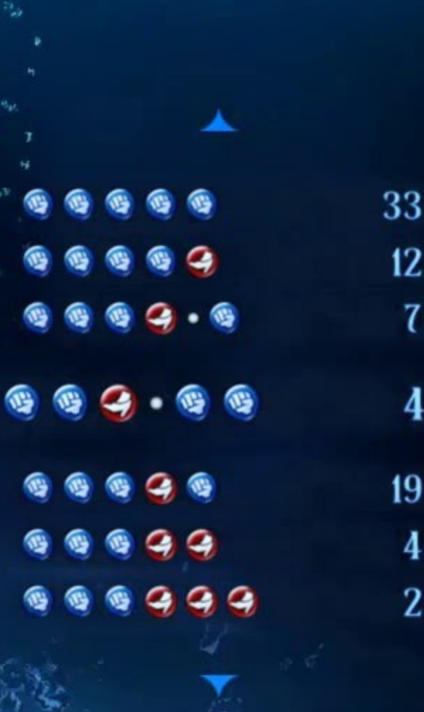
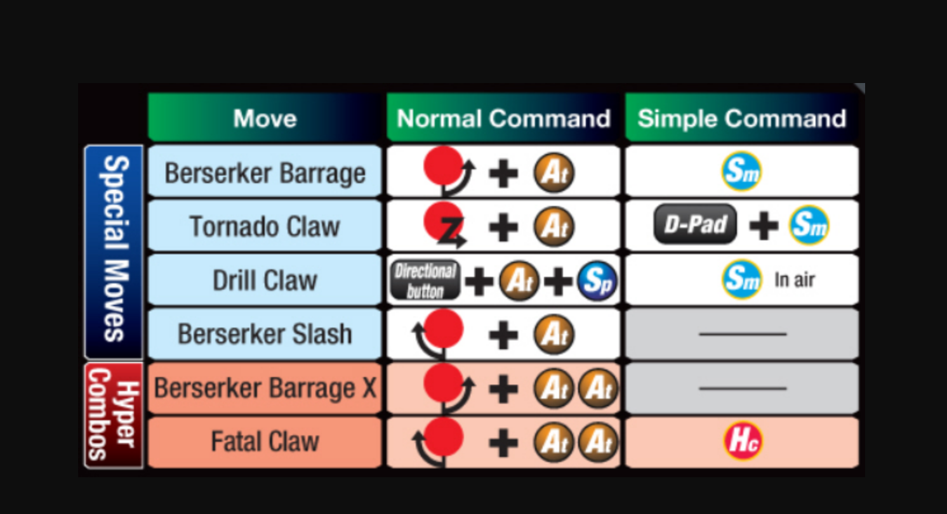
Game Mechanics
Combo System

Slide 9
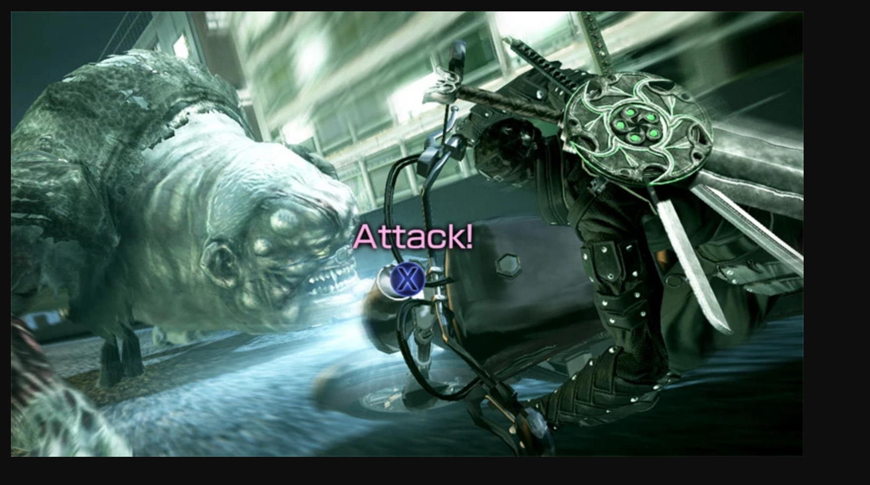
QuickTime Events
Using a QuickTime event to dodge or block depending on who you are playing as

Slide 10
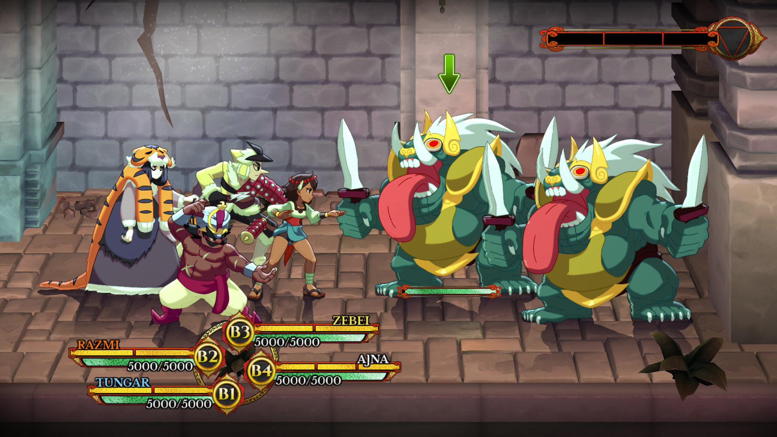
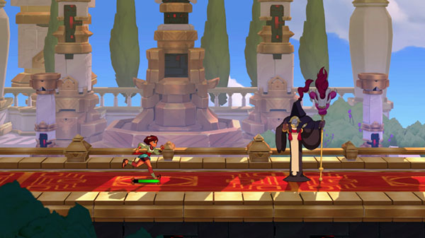
Mixing The Fighting Game genre is not new
Turn Based
MetroidVania
Turned Based Combat but with a combo system
Reaction time blocking
Allows you to play as a Metroidvania or turn based
Allows you to play as a Metroidvania or turn based

Slide 11
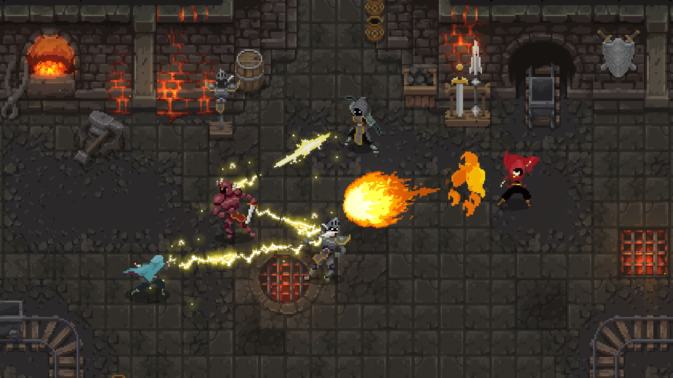
Things for the Future
Isometric view
Allows for more player choice
Have more options to play with more characters

